Slide 1

Simple Calendar App
A MERN Stack Application

Slide 2
Presented by:
Dhanakudharam. Venkata Padmavathi : U01944105
Sai Gnandeep Vangapandu : U01859740
Vinay Suhaas Gandi : U01951025
Naga sai purvaz bandalamudi : U01949350

Slide 3
Project Overview
A full-stack calendar application built using: MongoDB, Express.js, React, and Node.js
Enables users to:
View events on a calendar
Add new events by clicking a date
Persist events using a MongoDB backend

Slide 4
Technology Stack
Frontend: React, FullCalendar library, Axios
Backend: Express.js, Node.js
Database: MongoDB (Mongoose ODM)
Authentication: JWT (Token-based)
Dev Tools: Postman, Git, VS Code

Slide 5
Features
Full-featured calendar with:
Monthly view
Event creation by date click
Events saved and retrieved per user

Slide 6
Application Architecture
Frontend (React)
App.js uses FullCalendar
Axios to communicate with backend
Backend (Express)
/events: CRUD for events
MongoDB
Stores user accounts and event data

Slide 7
API Endpoints
POST : /events
GET : /events/:userId

Slide 8
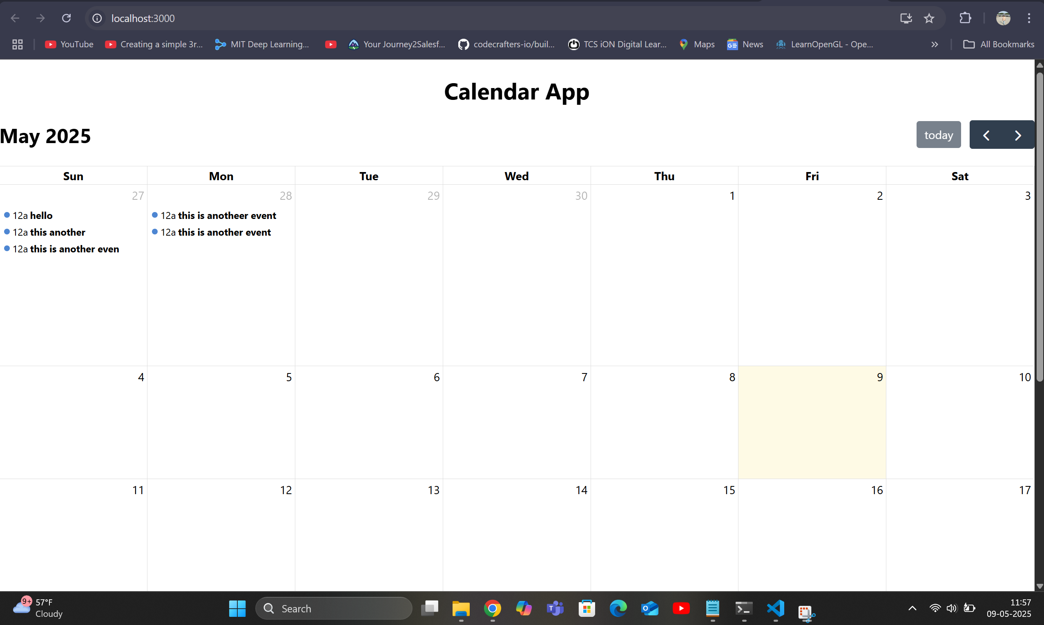
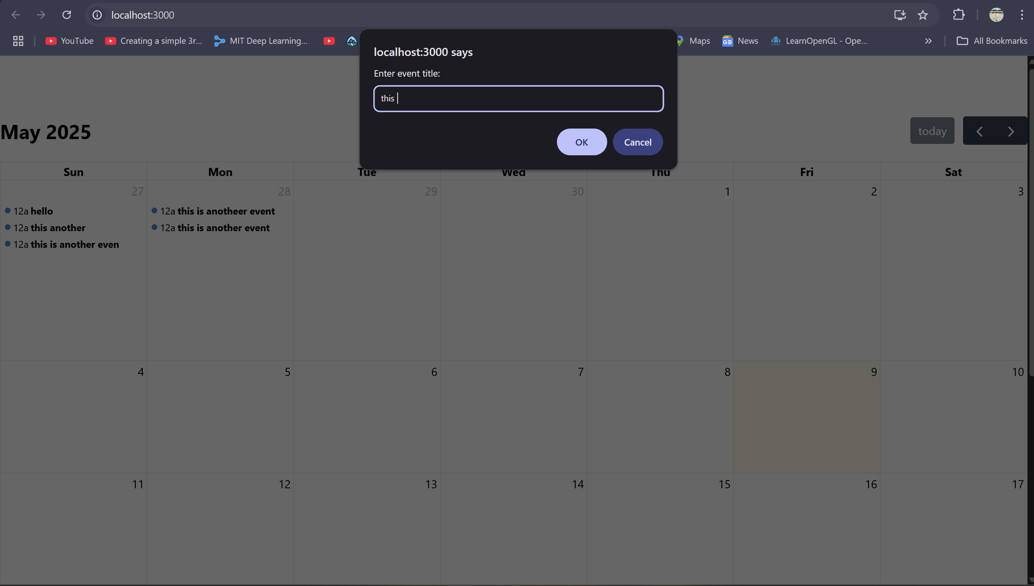
Demo

Slide 9
How to Run Locally
Client setup :
Cd client
Npm install
Node start
Server Setup:
Cd server
Npm install
Node server.js

Slide 10
Challenges & Learnings
Challenges:
Setting up CORS properly
Token-based route protection
Learnings:
Full-stack app flow
JWT and middleware usage
API testing with Postman

Slide 11
Future Improvements
UI enhancements with modals
Delete/update events
Replace prompt() with a proper form
Deploy using Vercel (client) and Render (backend)

Slide 12
Thank You

